Slide 1








Smart Street Light Control System Via sms
A presentation on the benefits of Smart Street Light Control, exploring its functionality, implementation, and potential impact.

Slide 2

Presented by:
Mohammed Musaib [3BR22EC095]
Mohammed Roshan [3BR22EC097]
Mohammed Shadaab [3BR22EC098]
Nethra B [3BR22EC109]
Under the Guidance of: Ms. Harshitha K R
Ballari Institute of Technology & Management,
Academic Year: 2024-2025

Slide 3
Introduction
A smart street light control system via SMS is a technology that allows for remote management and control of street lights using text messages. This system offers several advantages over traditional street lighting systems.

Slide 4
Literature Review:-
Relevant Research:
IoT-based Smart Street Light Fault Detection Management System (2024)
Smart Street Lighting System with Fault Detection (2022)
Advanced Street Light System using IoT (2020)
Insights:
Integrating sensors and communication modules improves efficiency.
Fault detection mechanisms enhance operational reliability.

Slide 5
Proposed Solution :-
Objective:
Design and implement a Smart Street Lighting System that:
Enables remote control via SMS.
Enhances public safety and energy efficiency.
Key Technologies:
IoT, sensors, and ESP8266.

Slide 6
Methodology:-
Hardware Setup:
Components: NodeMCU microcontroller,LDR sensors, LEDs,risestor.Power supply.
Software Implementation:
NodeMCU programming using Arduino IDE.
Real-time ambient light monitoring and dynamic adjustment.
Fault detection algorithms and ThingSpeak integration for remote notifications.

Slide 7
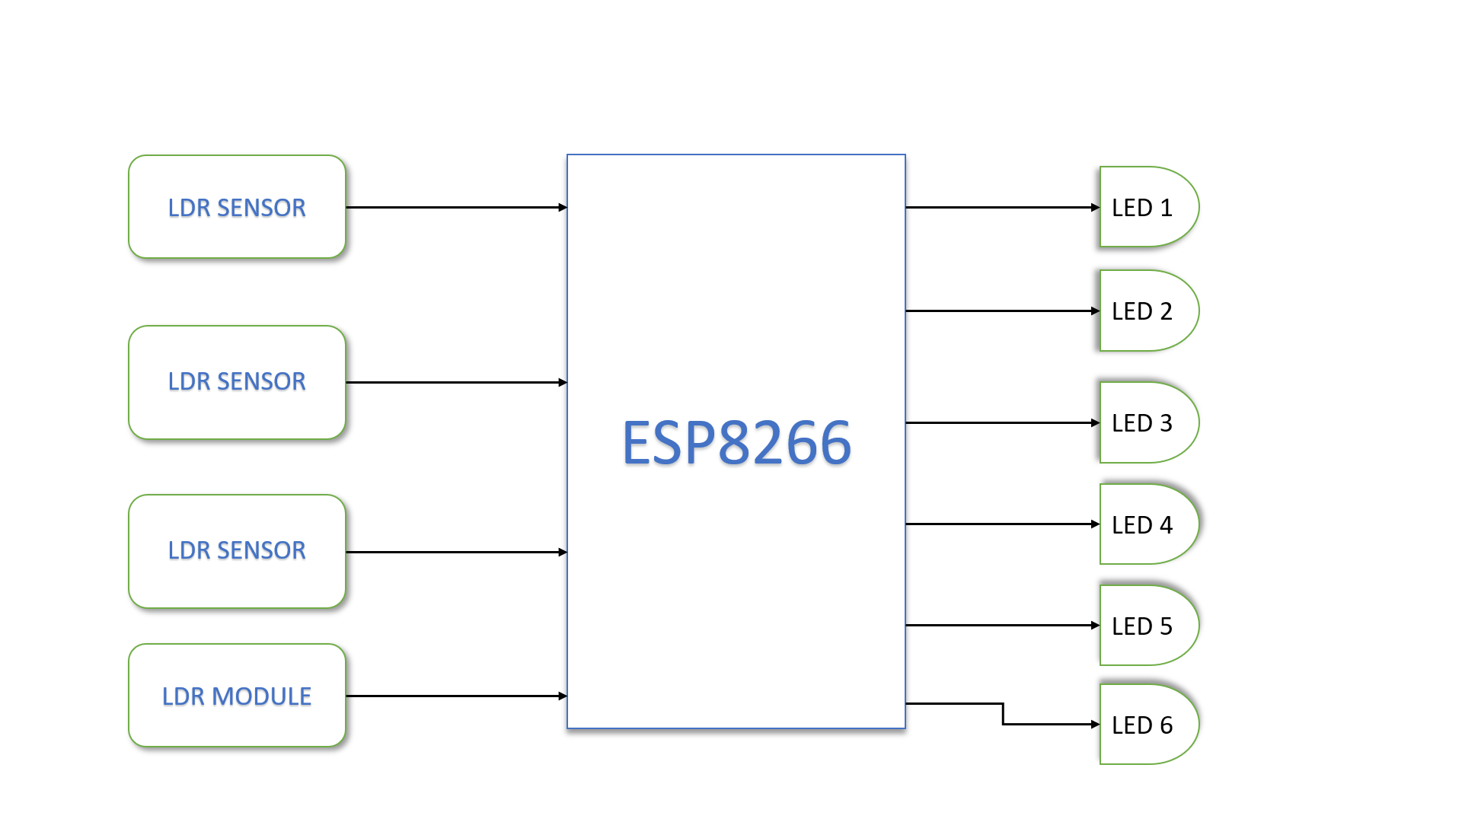
Block Diagram:-

Slide 8
Working principle:-
The system integrates IoT-enabled sensors to dynamically control street lighting.
LDR sensors monitor ambient light levels.
NodeMCU microcontroller facilitates remote control and fault notifications via SMS.
Fault detection algorithms identify anomalies and trigger maintenance alerts.

Slide 9
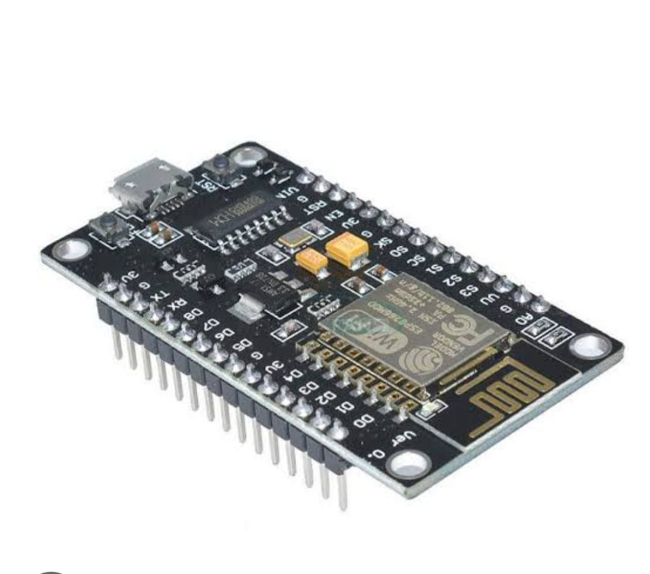








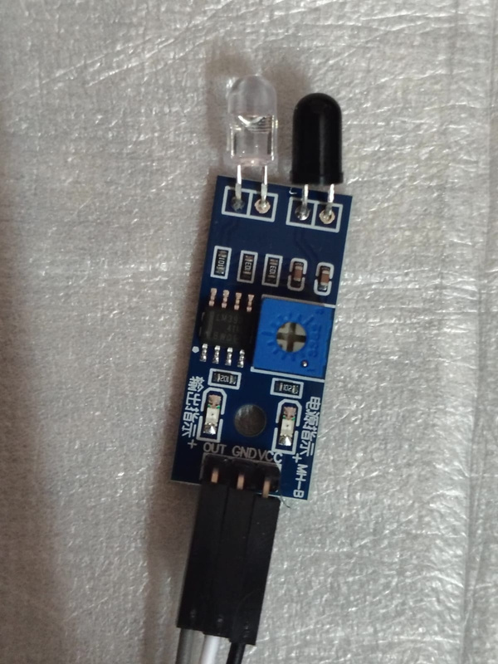
Compoment requried
Microcontroller: NodeMCU8266
Sensors: LDR
Power Supply
LED Lights, resistor, jumper wires.

Slide 10
Expected Outcomes:-
Energy Efficiency:
Reduced energy consumption and lower electricity bills.
Public Safety:
Enhanced visibility and reduced accidents/crimes.
Technological Advancements:
Real-world testing of emerging technologies.

Slide 11
Advantages:-
Energy Efficiency.
Improved Public Safety.
Enhanced visibility reduces accidents and crime.
Environmental Impact.
Cost-Effectiveness.
Reduced maintenance costs.
Technological Advancement.
Integration of cutting-edge IoT and communication technologies.

Slide 12
Challenges:-
Hardware Limitations:Ensuring durability of sensors and microcontrollers in outdoor conditions.
Connectivity Issues:Maintaining consistent GSM and IoT connectivity in remote areas.
Initial Costs:Higher initial investment for infrastructure setup.
Fault Detection Accuracy:Refining algorithms to reduce false positives.

Slide 13
Conclusion:-
Summary:
The Smart Street Light Control system addresses key inefficiencies in traditional systems.
By leveraging IoT and SMS-based control, it enhances energy efficiency, safety, and sustainability.
Future Scope:
Expand integration with renewable energy sources.
By Integerating AI will enable Predictive Analysis.

Slide 14
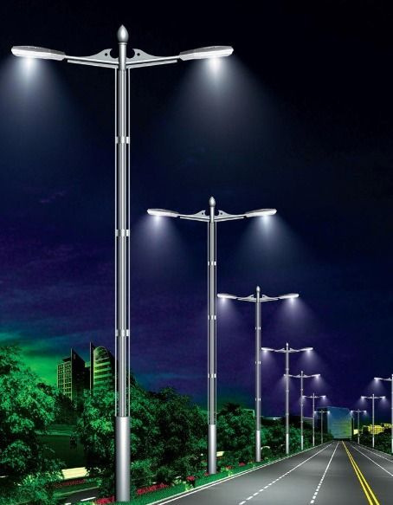
THANK YOU...!!

